Slide 1
Re-Engagement of ROP Education Services

Slide 2
Public Health Considerations
The virus that causes COVID-19 can infect people of all ages, and school leaders should do everything feasible to keep students, teachers, staff, and our communities safe. That said, research from the Centers for Disease Control (CDC), among others, has found that while children do get infected by COVID-19 and some severe outcomes have been reported in children, relatively few children with COVID-19 are hospitalized or have severe symptoms.

Slide 3
Guiding Principles
Focus on health and well-being of staff, students, and visitors across all programs.
Design a phased approach that will allow us to hold steady, tighten restrictions, or make changes to reflect new guidance.
Support work and course schedules that maintain physical distancing and consider hybrid schedules that blend both on-campus and online options.
Remain flexible and quickly adjust as new data become available or conditions in our schools change.

Slide 4
Student Learning and Thriving
Students in the U.S. lose a month’s worth of learning over the summer
Research shows students falling months behind during virus disruptions
Schools provide important social support, especially to vulnerable students
Connect, problem-solve, and network with peers
Social / emotional connection for students
Children learn best when physically present in the classroom

Slide 5
PREVENT: Practices to Prevent the Virus from Entering the School
Action 1: Health and Hygiene Practices: Masks and Temperature Checks
Action 2: Infection Control and Mitigation Strategies: Operational (Physical/Social Distancing)
Action 3: Cleaning Standards: On-Campus Hygiene
Action 4: Staff Intrinsic Motivation
Action 5: Instructional Model
Action 6: General Preparation: Professional Development

Slide 6
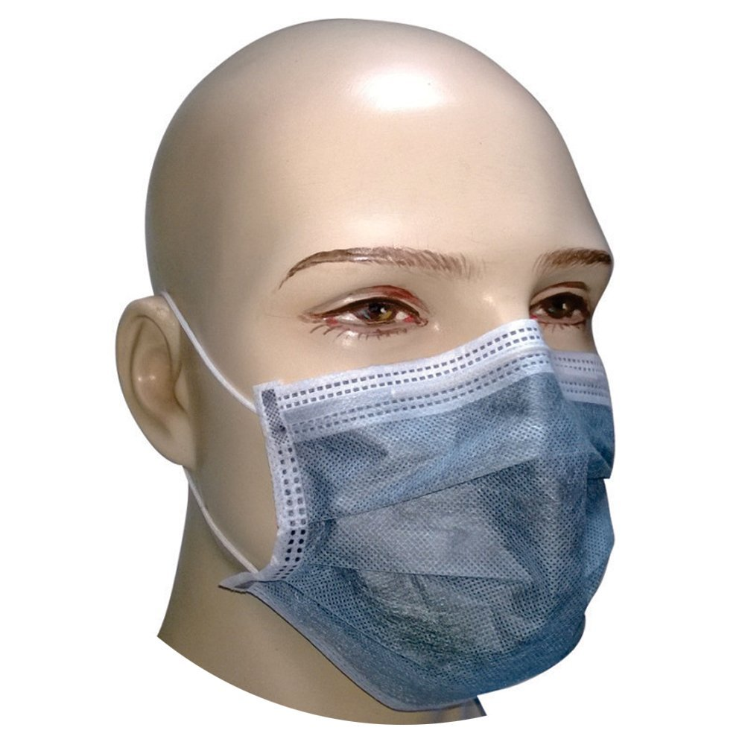
Health and Hygiene Practices: Masks
To reduce the spread of COVID-19, CDC recommends that people wear cloth face coverings in public settings when around people outside of their household, especially when other social distancing measures are difficult to maintain.
Face coverings may help prevent people who have COVID-19 from spreading the virus to others.
Every ROP student shall wear a face covering over the nose and mouth when inside any portion of the school building
Other building or space open to the public
In an outdoor public space, wherever it is not feasible to maintain six feet of social distancing from another person not in the same household

Slide 7
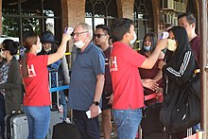
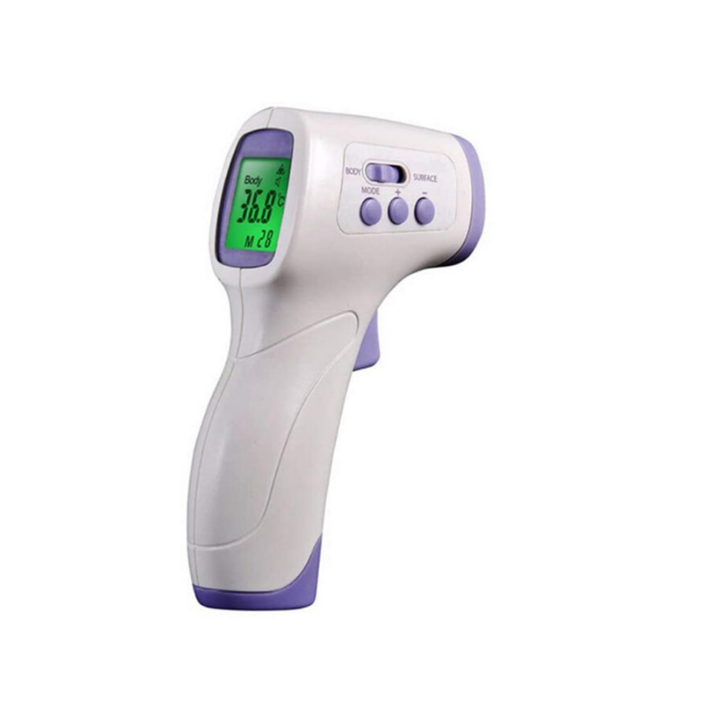
Health and Hygiene Practices: Temperature Checks
Screen students, employees, and visitors upon arrival
Screen for Symptoms: Temperature Checks
Ideally, temperature checks should happen before the individual enters the school/facility.

Slide 8
On-Campus Hygiene
Cleaning of classrooms between different class groups (objects such as door handles, common tables/desks, and high touch devices such as shared chrome books, etc.) – routine cleaning and disinfection
Provide hand sanitizer at each entrance, offices, and classrooms (interactive supervision is critical)
Establish schedule for restroom breaks and hand-washing throughout the day
Instruct students on good handwashing techniques and provide frequent opportunities to wash their hands throughout the school day
Discourage supply sharing of items that are difficult to clean or disinfect
Provide bottle/cup of water for students to avoid use of water fountains (no sharing)
Encourage Respiratory Etiquette: Encourage staff members to practice respiratory etiquette and instruct students to do the same.
Clean bus/vans after each trip (high-touch surfaces such as seats, steering wheels, knobs, and door handles)

Slide 9
Physical/Social Distancing
Social distancing, also called “physical distancing,” means keeping a safe space between yourself and other people who are not from your household.
To practice social or physical distancing, stay at least 6 feet (about 2 arms’ length) from other people who are not from your household in both indoor and outdoor spaces.

Slide 10
ROP Physical/Social Distancing
Apply minimum classroom space and maximum class size requirements. When determining the number of students in a classroom group in a typical classroom space, the school must apply the following factors:
Maximum of 15 people per classroom: No more than 15 total individuals can group in a typical classroom space (i.e., not a cafeteria, gym, library, or other larger space.)
Desks 6 ft. apart: Student desks (or seats at a table if tables are used) must be placed in a minimum of three feet (with healthy cohorts) six feet apart if possible.
It is highly recommended that students face the same direction rather than facing each other unless it is not possible.

Slide 11
Physical/Social Distancing
No large group gatherings
Use of consistent grouping when possible
Group or pair work allowable in a healthy cohort (American Academy of Pediatrics-)
Reduce hallway crowding (create one-way movement)
Gather outside where possible
Plan for entry and exit procedures (arrivals, dismissal, visitors, etc.)
Parent meetings via Zoom and by appointment only
Limit mixing groups
Reduce number of bus/van riders and encourage air flow (keep windows open as long as it is safe)
No sharing of technology without properly sanitizing before next user

Slide 12
Benefits of Teaching at ROP
Caring and supportive working environment
Possible use of physical dividers on desks
Proactive with use of fogger, protective glass to minimize contact
Low rate of virus transmittal from students (students are quarantined)
Ability to create social distancing with student enrollment numbers (25-30 students in a typical public schools)
Enrollment process for new intakes for current students and staff protection

Slide 13
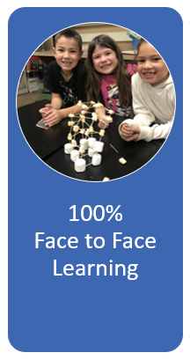
ROP Instructional Models: Face-to-Face Learning
Why is this Important?
Best pedagogical approach
Connect, problem-solve, and network with peers
Disparity in remote learning
Best meet individual student needs
Central social development / emotional connection for students
Ability to participate in extracurricular activities

Slide 14
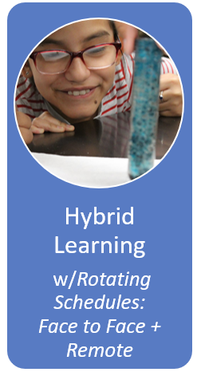
Hybrid Learning
Face to Face Learning w/Rotating Schedules Why? Social Distancing
Models Proposed by Ed Leaders:
A/B Day: ½ attend on Mon/Weds, ½ attend Tues/Thurs
A/B Week: ½ attend one week; ½ attend the next week
AM/PM: ½ attend morning; ½ attend afternoon (recommended)

Slide 15
Hybrid Learning what could be new in 2020-21
Challenges in Social Distancing at School
Arrival
Dismissal
Buses/Vans
Lunches
Class Transitions
Restroom Breaks
PE / Athletics
Career Technical Education
Extracurricular Activities
Maintaining Distance in all places
Hand Washing

Slide 16
General Preparation
Prepare & post summary of practices for COVID19 mitigation
Prepare summary of practices of your School plan to use to mitigate COVID-19 spread
Post summary of practices online and in conspicuous places at School facilities.
2. Provide staff training
Train staff on all safety protocols.
Provide specific training based on job position and responsibilities (e.g., employees who will administer temperature checks, employees who will clean and disinfect, drivers, etc.).
Conduct training virtually if needed

Slide 17
Let’s Get To Teaching…..
Educate students with fidelity.
Determine resources and support needed to guide each student to success.
Understand the importance of health and hygiene practices.
Consider the safety of everyone around you.
Ask and answer questions of staff and students.
Talk to students about the importance of learning.
It is our responsibility to impact the lives of our youth.
Our goal is to close the achievement gaps.
Now let’s prepare to educate students in a safe and normalize learning environment.

